Slide 1
Dijkstra’s Algorithm
Thao Nguyen and Joshua Nowak

Slide 2
How It Works
Step 1: Declare three unordered_maps to take vertex labels as keys
std::unordered_map<std::string, unsigned long> distances
std::unordered_map<std::string, bool> visited
std::unordered_map<std::string, std::string> predecessors
Step 2: Initialize all vertices’ “distances” values as std::numeric_limit<unsigned long>::max() and “visited” values as false. Change the start vertex’s distance to 0.
Step 3: Initialize priority queue to take pairs of unsigned long distances and string labels. Push the data of the start vertex to the priority queue.
While priority queue is not empty:
Step 4: Pop priority queue and mark current vertex as visited.
Step 5: Check all incident edges of current vertex. If !visited[adjacent] && distances[current] + weight < distances[adjacent]:
Relaxation: distances[adjacent] = distances[current] + weight
predecessors[adjacent] = current
Push data of adjacent vertex to priority queue.
Step 6: Construct shortest path between start and end vertex via predecessors.

Slide 3
Steps 1-3 for g.shortestPath("1", "5", path)
start
label | distances | visited | predecessors
1 | 0 | false
2 | ∞ | false
3 | ∞ | false
4 | ∞ | false
5 | ∞ | false
6 | ∞ | false
1
2
7
9
10
3
14
15
2
11
6
4
9
6
5
Priority Queue: 1
end

Slide 4
Steps 4-5 for g.shortestPath("1", "5", path)
start
label | distances | visited | predecessors
1 | 0 | true
2 | 7 | false | 1
3 | 9 | false | 1
4 | ∞ | false
5 | ∞ | false
6 | 14 | false | 1
1
2
7
9
10
3
14
15
2
11
6
4
9
6
5
Priority Queue: 2, 3, 6
end

Slide 5
Steps 4-5 for g.shortestPath("1", "5", path)
start
label | distances | visited | predecessors
1 | 0 | true
2 | 7 | true | 1
3 | 9 | false | 1
4 | 22 | false | 2
5 | ∞ | false
6 | 14 | false | 1
1
2
7
9
10
3
14
15
2
11
6
4
9
6
5
Priority Queue: 3, 6, 4
end

Slide 6
Steps 4-5 for g.shortestPath("1", "5", path)
start
label | distances | visited | predecessors
1 | 0 | true
2 | 7 | true | 1
3 | 9 | true | 1
4 | 20 | false | 3
5 | ∞ | false
6 | 11 | false | 3
1
2
7
9
10
3
14
15
2
11
6
4
9
6
5
Priority Queue: 6, 4
end

Slide 7
Steps 4-5 for g.shortestPath("1", "5", path)
start
label | distances | visited | predecessors
1 | 0 | true
2 | 7 | true | 1
3 | 9 | true | 1
4 | 20 | false | 3
5 | 20 | false | 6
6 | 11 | true | 3
1
2
7
9
10
3
14
15
2
11
6
4
9
6
5
Priority Queue: 4, 5
end

Slide 8
Steps 4-5 for g.shortestPath("1", "5", path)
start
label | distances | visited | predecessors
1 | 0 | true
2 | 7 | true | 1
3 | 9 | true | 1
4 | 20 | true | 3
5 | 20 | false | 6
6 | 11 | true | 3
1
2
7
9
10
3
14
15
2
11
6
4
9
6
5
Priority Queue: 5
end

Slide 9
Steps 4-5 for g.shortestPath("1", "5", path)
start
label | distances | visited | predecessors
1 | 0 | true
2 | 7 | true | 1
3 | 9 | true | 1
4 | 20 | true | 3
5 | 20 | true | 6
6 | 11 | true | 3
1
2
7
9
10
3
14
15
2
11
6
4
9
6
5
Priority Queue: 4, 5
end

Slide 10
Step 6 for g.shortestPath("1", "5", path)
start
label | distances | visited | predecessors
1 | 0 | true
2 | 7 | true | 1
3 | 9 | true | 1
4 | 20 | true | 3
5 | 20 | true | 6
6 | 11 | true | 3
1
2
7
9
10
3
14
15
2
11
6
4
9
6
5
Path: 1, 3, 6, 5 return 20;
end

Slide 11
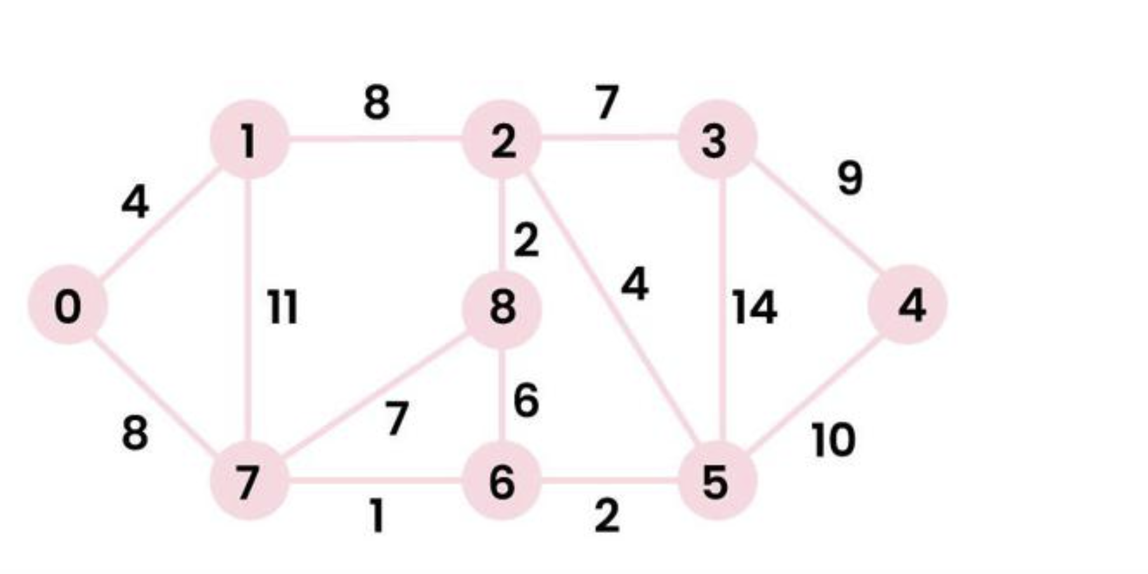
Another Example
g.shortestPath(“0”, “5”, &path) = 11
path = 0, 7, 6, 5
g.shortestPath(“0”, “4”, &path) = 21
path = 0, 7, 6, 5, 4
g.shortestPath(“7”, “3”, &path) = 14
path = 7, 6, 5, 2, 3

